Slide 1

Technological Harmonisation & Procedural Harmonisation
WP2 & WP3
V. Cardin, L. Coppola, R. Bonzano, S. Pensieri, G. Petihakis
NERC, OGS, UiB, PLOCAN, IFREMER, INGV, UNIABDN, CNRS, GEOMAR, IEO, INDP, UPC, 52o NORTH, CNR, IMAR

Slide 2
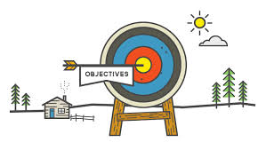
Objectives
FixO3 WP 2 & 3
To harmonise procedures across the network:
Assessment of operational procedures for sustained Eulerian observations
Development of principles of “best practice”
Development of the FixO3 observatories “label”
Notes:
Day to day operations on fixed installations are crucial and often very demanding. Fixed observatories around Europe have been developed by individual efforts and thus to a large extent in an uncoordinated way, guided by national priorities and funds.
Furthermore a wide variability of procedures adopted across Europe demands harmonization actions aiming towards the adoption of best practices and the subsequent reduction of costs.

Slide 3
Activities
FixO3 WP 2 & 3
Assessment of procedures
Partners were asked to share any existing documentation such as protocols, standard operation procedures, etc. → standardized template.
During the GA meeting in Heraklion partners had the opportunity to extensively discuss the documents and agreed about the WS
4th - 5th of December 2014 Athens common WS
Principal investigators of the FixO3 network of observatories as well as technicians and scientists who actually operate the stations were invited to attend the workshop.

Slide 4
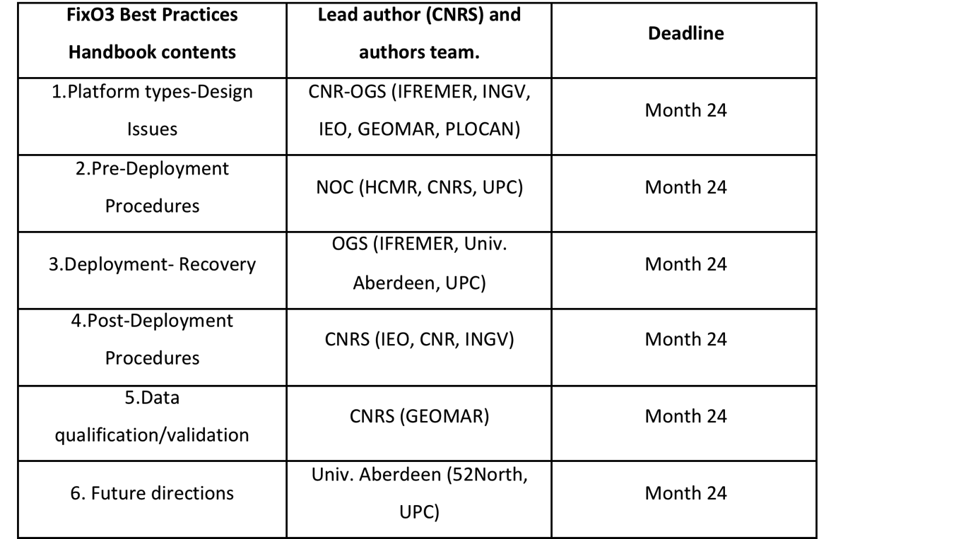
Activities
FixO3 WP 2 & 3
Principles of “best practice”
A major goal of the workshop was to structure the FixO3 Best Practices Handbook.
Working group leaders and drafting groups were appointed for each section and deadlines were set.

Slide 5
Handbook on best practices
FixO3 WP 2 & 3
Notes:
A handbook describing the “best practices” in all phases of the system covering the entire infrastructural chain of data acquisition was produced.
In this handbook there are recommendations on how to produce high quality data aiming towards common methodologies and protocols within the network

Slide 6
FixO3 WP 2 & 3
Handbook on best practices - Content

Slide 7
FixO3 WP 2 & 3

Slide 8
FixO3 WP 2 & 3

Slide 9
Collaboration
FixO3 WP 2 & 3
  External links
JERICO – JERICO NEXT
ATLANTOS
  Best Practices
  Label
FixO3
EMSO
EuroArgo

Slide 10

Future plans
Update the Best Practices Handbook
  New knowledge acquired from the day-to-day operations
  Experience from TNA projects
Work on the LABEL
  Evaluate the parts of the Best Practices Handbook that can go into the LABEL
  Identify and work on the sections of the Best Practices which need more work in terms of the LABEL
  Incorporate the TNA project experience

Slide 11
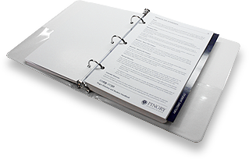

Expected results
FixO3 WP 2 & 3
Best Practices
FixO3
LABEL

